Slide 1
PHP in the Cloud
Zeev Suraski |Co-Founder & CTO, Zend

Slide 2
A bit about me & Zend

Slide 3



About Me
Managed to graduate CS at the Technion, Israel Institute of Technology
3 children
Photography enthusiast
Early technological career – GW-BASIC apps, C++ CGIs, C&C army systems
Co-creator of PHP, Co-founder & CTO of Zend

Slide 4
About Zend
Co-founded by Zeev Suraski and Andi Gutmans, co-creators of PHP and the PHP runtime (Zend Engine)
A software company selling into Enterprise & SMB:
Contributor to Open Source projects - PHP, PDT and ZF
Presence in Israel, US, Germany, France, Italy and Ireland
Partnerships with IBM, Oracle, Adobe & more
Venture backed

Slide 5
A bit about PHP

Slide 6

Over One Third of the Web Runs on PHP

Slide 7

4+ million developers

Slide 8

Enterprise PHP Adoption Accelerates
PHP Developers
5M
“Commercial and corporate IT developers will account for more than 2 million PHP community members—growing from 20% to 50% of the worldwide PHP developer population.”
4M
3M
2M
1M
2009
2013
Non-commercial developers
Commercial and corporate IT developers
Gartner Research Note: “PHP: Past, Present and Future”, Dec. 2nd, 2009

Slide 9









PHP’s Recipe for Success
Developer’s Affinity
Applications Ecosystem

Slide 10
PHP in the Cloud

Slide 11

Zeev’s Phone, October 2010

Slide 12

Zeev’s Phone, November 2010

Slide 13

Mobile
Cloud
Social

Slide 14
The Next Generation of Web Workloads
Delivers great end-user experience
Evolves quickly
APIs Everywhere
Elastic
Build on open de-facto standards

Slide 15
Zend Enabling You In The New Era
Quantum leap in development productivity
The best scale-out production environment
The cloud of your choice

Slide 16





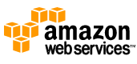

Introducing phpcloud.com
Developer Cloud
Production Cloud
Self-serve
Integrated
Consistent
Productive
Collaborative
Amazon Web Services
IBM SmartCloud
RightScale
Rackspace
Private Cloud
Eclipse PDT
CLI
Automation
Application Fabric
(powered by Zend Server)

Slide 17






Zend Developer Cloud: Redefining Web Development
Instant Setup
Spin-up Development sandbox within seconds
High productivity
Strong IDE and CLI integration
Powerful debugging
Code traces, debugging, alerts
Collaboration with peers and stakeholders
Clone a full stack
Deployment with confidence
Create production-ready packages

Slide 18
phpcloud.com demo

Slide 19


Zend Application Fabric: Fast. Elastic. Dependable.
Elastic
Auto-scaling
Automated App
Deployment
Fast
Application Performance Mgmt
Caching
Job Queue
Dependable
High Availability
Monitoring
Code Tracing
Support
Hot Fixes
Run on any cloud

Slide 20

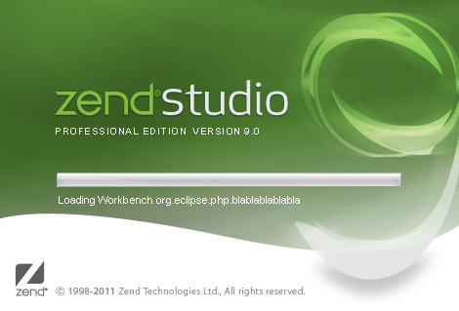
Zend Studio 9 Available: Faster. Better. Streamlined.
Cloud
Git & GitHub
Easier debugging
Application deployment
Faster & lighter weight
Better HTML 5, Javascript, CSS3
Built on Eclipse 3.7 (Indigo)

Slide 21


Summary

Slide 22
Merci! zeev@zend.com @zeevs

